Slide 1

DATA 1200 – INTRODUCTION TO DATA ANALYSIS
PROFESOR: Sam Plati

Slide 2
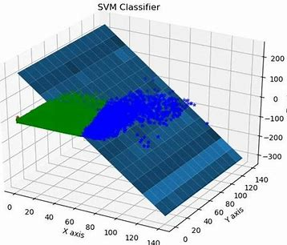
Assignment: 4 SVM AND NAÏVE BAYES
PREPARED BY: Abdulrahman Ramsey Momodu
Student ID: 100864843
Date Submitted: 11/11/2022

Slide 3
Details of the Data Mr. John Hughes has been thinking that maybe a SVM and Naïve Bayes model might produce better results for the HCV_Dataset.csv dataset that you used in Assignment 3.
The dataset has 589 observations and 13 variables:
Types of Variables
Dependent Variable:
Independent Variables: Age (in years) Sex (male=0,female=1)
Variables
Category : '0=Blood Donor', '0s=suspect Blood Donor', '1=Hepatitis', '2=Fibrosis
The Blood Attributes are ALB, ALP, ALT, AST, BIL, CHE, CHOL, CREA, GGT, PROT.

Slide 4
Questions
1. Create a Python Script using Jupyter Notebook (then convert to .html) - 2% a) Using Python develop both an SVM and Naïve Bayes algorithm script to predict Category. Attach the HTML copy of your Python Code with your submission. Note: All steps need to be annotated (i.e., Week7-SVMNBExample)
2. Create a PowerPoint (PPT or PPTX) presentation that includes the following:
Cover Page (Including Title, First and Last Name, Student Number)
Rational Statement (summary of the problem or problems to be addressed by the PPT) – 2%
Present the Boxplots and Explain two (2) key insights with associated explanations – 2%
Present the Confusion Matrix/Classification Report for both the SVM and Naïve Bayes Model and Explain three (3) key insights from the Model Metrics (i.e., Precision, Recall, F1) for each model. Note: six (6) insights in total are required – 6%
Recommend one (1) model to Mr. John Hughes and present three (3) improvements that could enhance the usability of the model. – 3%

Slide 5
The Rational Statement
Solution
To create or build a model for predicting blood type: '0=Blood Donor,' '0s=Suspicious Blood Donor,' '1=Hepatitis,' '2=Fibrosis'
To create this model, Python-Jupyter Notebook will be utilized or used to test the HCV dataset.
To determine if the data distribution is normal or skewed, the Boxplot would be drawn or plot
The confusion Matrix from the SVM and NAVE Bayes models will be used to measure the model's appropriateness using F1 Score, Precision, and Recall values.

Slide 6
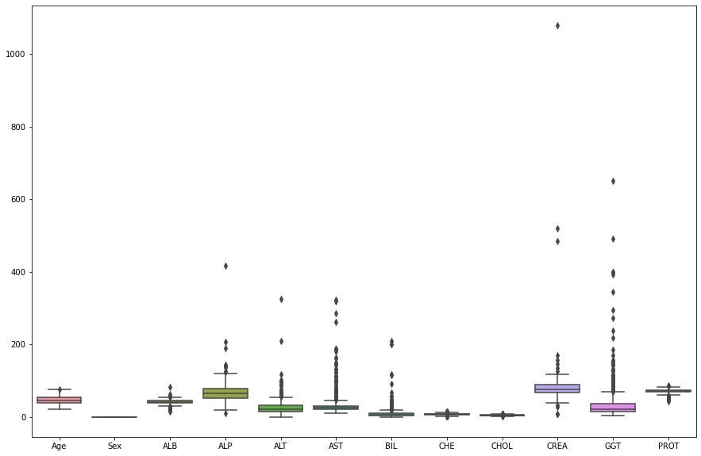
Boxplot
Outliers: A considerable number of outliers exist. Outliers exist in several independent variables, including ALP, ALT, AST, BIL, CREA, and GGT.
Uneven distribution. The median line is not in the Centre of the boxplot of the independent variables. this show that it is skewed

Slide 7
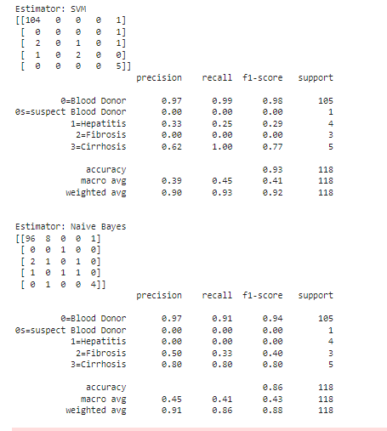
CONFUSION MATRIX/CLASSIFICATION REPORT
The confusion matrix, as seen in the results, is the output of the model's performance based on the test data (HCV dataset.)The confusion matrix is utilized to generate our Precision, Recall, and F1 statistics (HCV dataset. below)
SVM MODEL
NAÏVE BAYES MODEL
The weighted average precision value is 90%. It is highly suitable for predicting 0=Blood Donor up to 97%.
It has a precision value of 91% in the weighted average. It is most accurate in predicting 0=Blood Donor up to 97% and less accuracy in predicting 3=Cirrhosis at 80%.
The weighted average Recall value is 93%. The recall predicts 0=Blood Donor with 99% accuracy.
It has a weighted average recall of 86%, with an accuracy of 91% in predicting 0=Blood Donor and 80% in predicting 3=Cirrhosis.
It has a 92% F1-score. It has a 98% accuracy in predicting 0=Blood Donor.
With an F1-score of 88%. It can predict 0=Blood Donor with 94% accuracy and 3=Cirrhosis with 80% accuracy.

Slide 8
RECOMMENDATION I recommend SVM model for the following reasons:
1. Considering weight value (on the weighted avg) of F1-Score, SVM has a better ratio/accuracy of 92% against Naïve Bayes of 88%
2. Comparing values for weighted-avg of their Accuracy (on recall), SVM has 93% while Naive Bays has 86%, As a result of this outcome of both model, I will recommend SVM model
3. SVM has no underlying assumptions. Whereas, Naive Bayes has challenges dealing with unbalanced datasets. HCV_dataset used in this case is unbalanced and skewed, for this reason I will recommend SMV Model

Slide 9
3. Reducing the variables (blood category) would help to improve the model. SVM is very suitable in predicting 0=Blood Donor. Therefore, reducing the variables to two (0=Blood Donor and others) would improve the model.
THREE WAYS TO IMPROVE SVM MODEL
1. To improve this model, the dataset has to be balanced to get a more accurate representation of the prediction
2. The boxplot indicated presence of outliers in the dataset. Treating the outliers would help in optimizing the model.

Slide 10
References
Plati, Sam, 2022. Python Tutorials, Week4c – Tutorials - SLR
Plati, Sam, 2022. Predictive Modeling Part IV – SVM and Naïve Bayes
Plati, Sam, 2022. Python Tutorial, Week #7a –SVM_NB

